Slide 1
Programming II
(C Programming Language)
Functions in C
Lecture 9, Monday February 22, 2021
Dr. Ayman ALJARBOUH

Slide 2
Outline
C Standard Library Functions
C User-defined Functions
C Functions

Slide 3
C Functions
A function is a block of code (or a group of statements) that performs a specific task
Suppose, you need to create a program to create a circle and color it. You can create two functions to solve this problem
a function to create the circle, and
a function to color it
Dividing a complex problem into smaller chunks makes our program easy to understand to reuse
You can divide up your code into separate functions
Every C program has at least one function, which is main()

Slide 4
C Functions
There are two types of functions:
Standard library functions
functions which are already defined in C library, example printf(), scanf(), strcat() etc
You just need to include appropriate header files to use these functions
These are already declared and defined in C libraries
User-defined functions
functions which are defined by the user at the time of writing program
These functions are made for code reusability and for saving time and space
Notes:
- Major standard is SQL-1999 (=SQL3)
- Introduced “Object-Relational” concepts
- SQL 2003, SQL 2008 have small extensions
- SQL92 is a basic subset

Slide 5
Outline
C Standard Library Functions
C User-defined Functions
C Functions

Slide 6
C Standard Library Functions
The standard library functions are built-in functions in C programming
These functions are defined in header files
For example, printf() is a standard library function to display output on the screen
This function is defined in the stdio.h header file
Hence, to use the printf() function, we need to include the stdio.h header file using #include <stdio.h>
The sqrt() function calculates the square root of a number. The function is defined in the math.h header file
Notes:
- Major standard is SQL-1999 (=SQL3)
- Introduced “Object-Relational” concepts
- SQL 2003, SQL 2008 have small extensions
- SQL92 is a basic subset

Slide 7
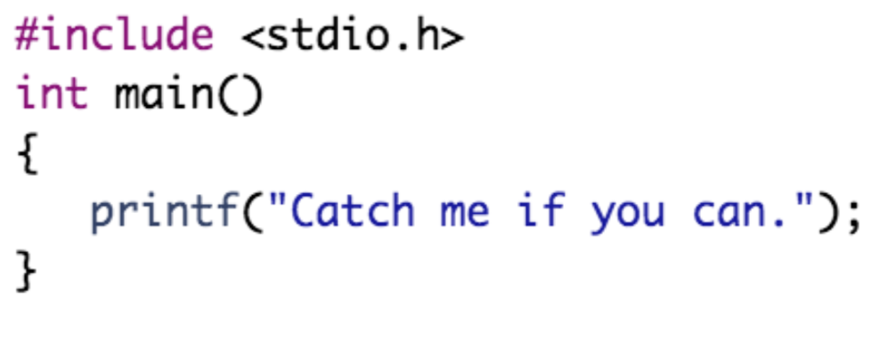
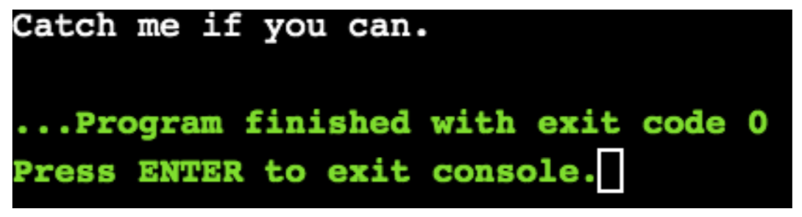
C Standard Library Functions
Example:
Output:

Slide 8
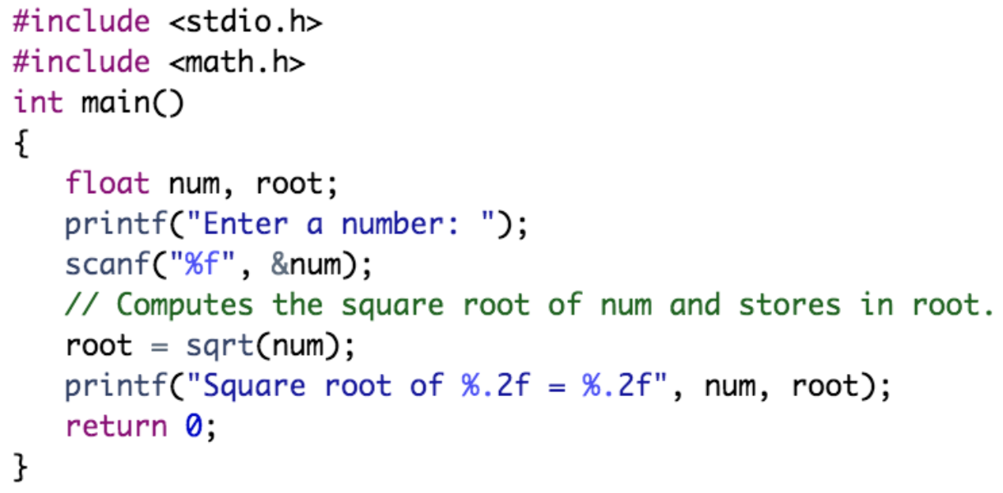
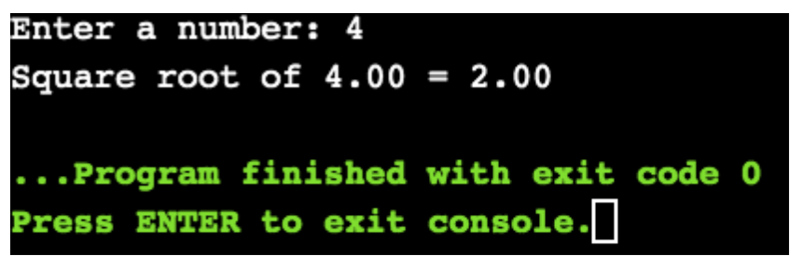
C Standard Library Functions
Example:
Output:

Slide 9
Outline
C Standard Library Functions
C User-defined Functions
C Functions

Slide 10
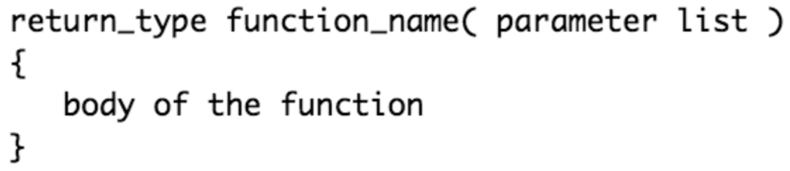
C User-defined Functions
User-defined functions are functions which are defined by the user at the time of writing program
Defining a User-defined Function
A function definition provides the actual body of the function
The general form of a function definition in C language is:
Return Type: The return_type is the data type of the value the function returns. A function may return a value. Some functions perform the desired operations without returning a value. In this case, the return_type is the keyword void
Notes:
- Major standard is SQL-1999 (=SQL3)
- Introduced “Object-Relational” concepts
- SQL 2003, SQL 2008 have small extensions
- SQL92 is a basic subset

Slide 11
C User-defined Functions
User-defined functions are functions which are defined by the user at the time of writing program
Defining a User-defined Function
A function definition provides the actual body of the function
The general form of a function definition in C language is:
Function Name: This is the actual name of the function
Notes:
- Major standard is SQL-1999 (=SQL3)
- Introduced “Object-Relational” concepts
- SQL 2003, SQL 2008 have small extensions
- SQL92 is a basic subset

Slide 12
C User-defined Functions
User-defined functions are functions which are defined by the user at the time of writing program
Defining a User-defined Function
A function definition provides the actual body of the function
The general form of a function definition in C language is:
Parameters: A parameter is like a placeholder. When a function is invoked, you pass a value to the parameter. Parameters are optional; that is, a function may contain no parameters
Notes:
- Major standard is SQL-1999 (=SQL3)
- Introduced “Object-Relational” concepts
- SQL 2003, SQL 2008 have small extensions
- SQL92 is a basic subset

Slide 13
C User-defined Functions
User-defined functions are functions which are defined by the user at the time of writing program
Defining a User-defined Function
A function definition provides the actual body of the function
The general form of a function definition in C language is:
Function Body: The function body contains a collection of statements that define what the function does
Notes:
- Major standard is SQL-1999 (=SQL3)
- Introduced “Object-Relational” concepts
- SQL 2003, SQL 2008 have small extensions
- SQL92 is a basic subset

Slide 14
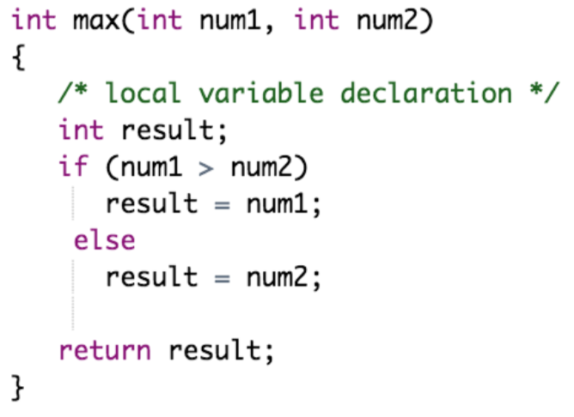
C User-defined Functions
Example of defining a user-defined function:
The function max() takes two parameters num1 and num2 and returns the maximum between them

Slide 15

C User-defined Functions
A function declaration tells the compiler about a function name and how to call the function
Declaring a User-defined Function
The general form of a function declaration in C language is:
Example:
Parameter names are not important in function declaration; only their type is required
Notes:
- Major standard is SQL-1999 (=SQL3)
- Introduced “Object-Relational” concepts
- SQL 2003, SQL 2008 have small extensions
- SQL92 is a basic subset

Slide 16
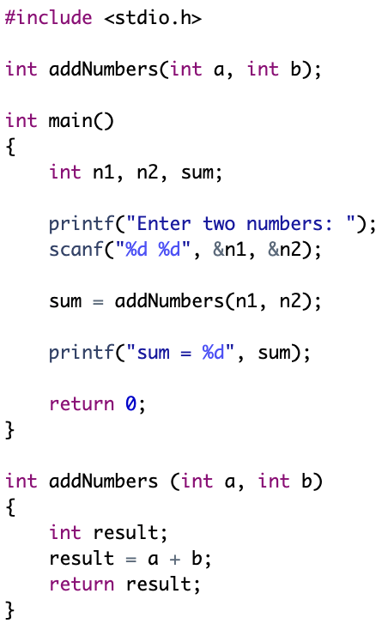
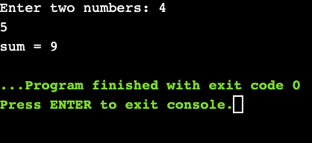
C User-defined Functions
Output:
Example:
Function Declaration
Function Call
Function Definition

Slide 17
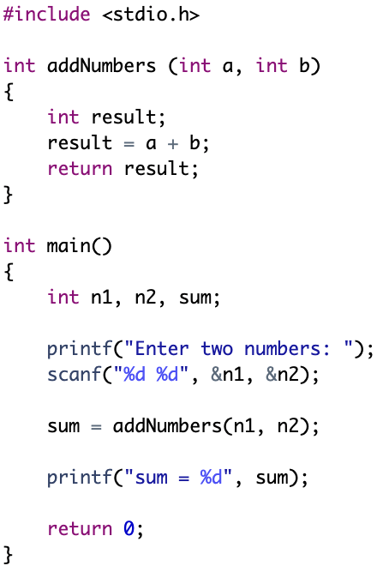
C User-defined Functions
Output:
Example:
Function Definition
Function Call

Slide 18
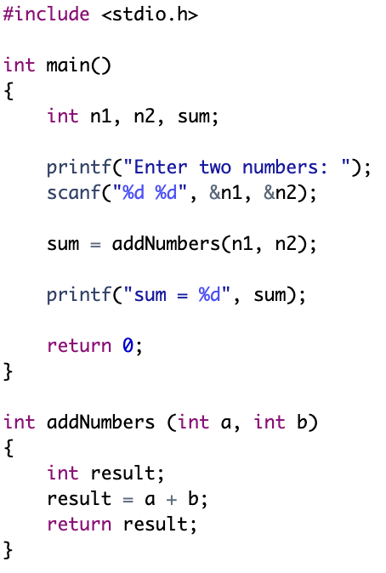
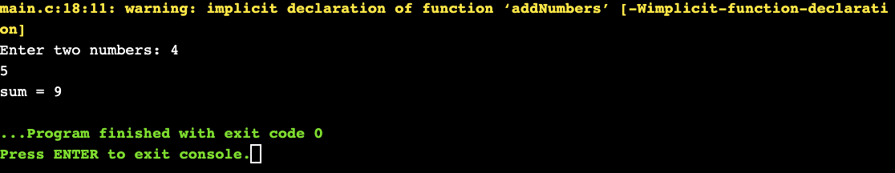
C User-defined Functions
Output:
Example:
Function Call
Function Definition

Slide 19
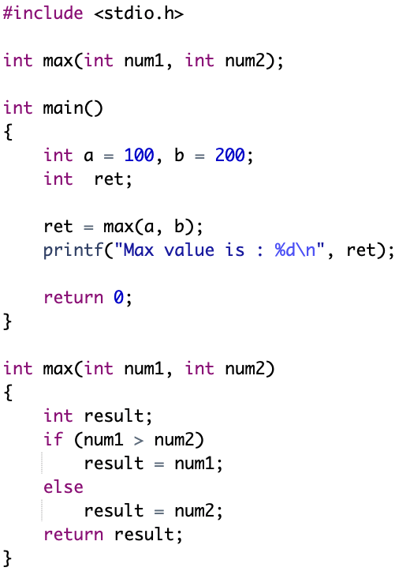
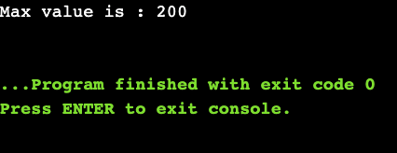
C User-defined Functions
Output:
Example:

Slide 20
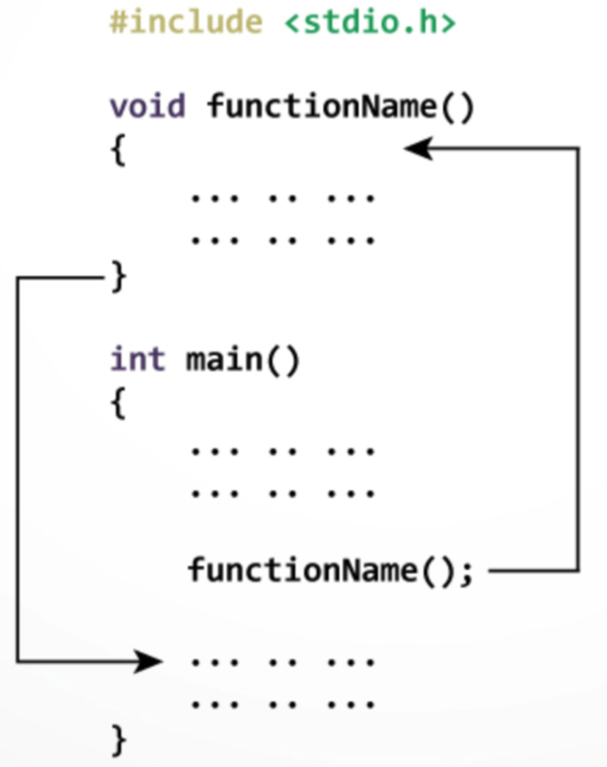
C User-defined Functions
How User-Defined Functions Work?
The execution of a C program begins from the main() function
When the compiler encounters the function call, control of the program jumps to the function definition, and starts executing the code inside the function
Once code inside the function definition is executed, the control of the program jumps back to the main() function

Slide 21
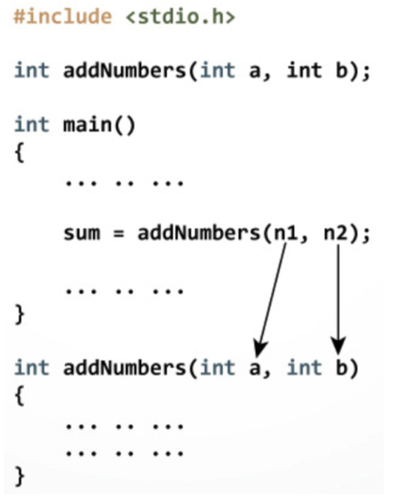
C User-defined Functions
Passing Arguments to a Function
In the example:
Two variables n1 and n2 are passed during the function call
The parameters a and b accept the passed arguments in the function definition
The type of arguments passed to a function and the function parameters must match, otherwise, the compiler will throw an error

Slide 22
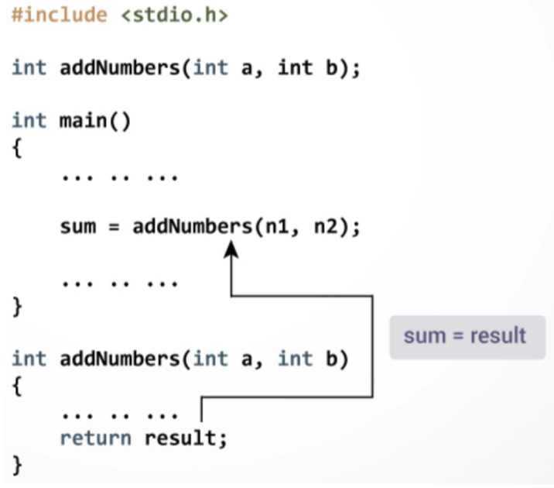
C User-defined Functions
Return Statement
The return statement terminates the execution of a function and returns a value
The program control is transferred to the calling function after the return statement
In the example, the value of the result variable is returned to the main function. The sum variable in the main function is assigned this value

Slide 23
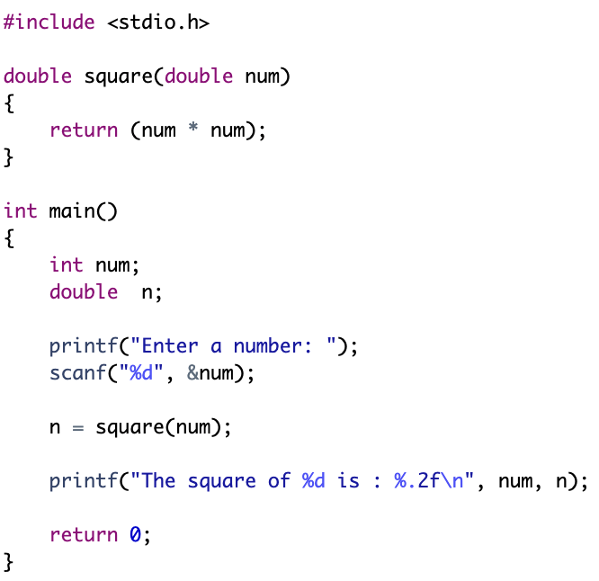
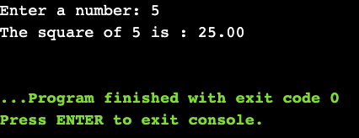
C User-defined Functions
Output:
Example:

Slide 24
Practical Exercises
Write and Compile the following C programs:
Program 1:

Slide 25
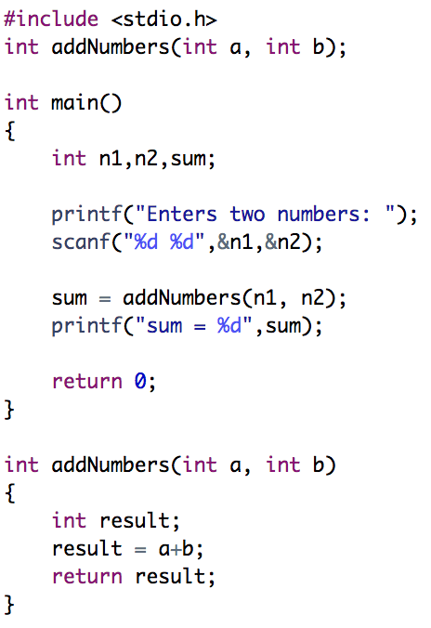
Practical Exercises
Write and Compile the following C programs:
Program 2:

Slide 26
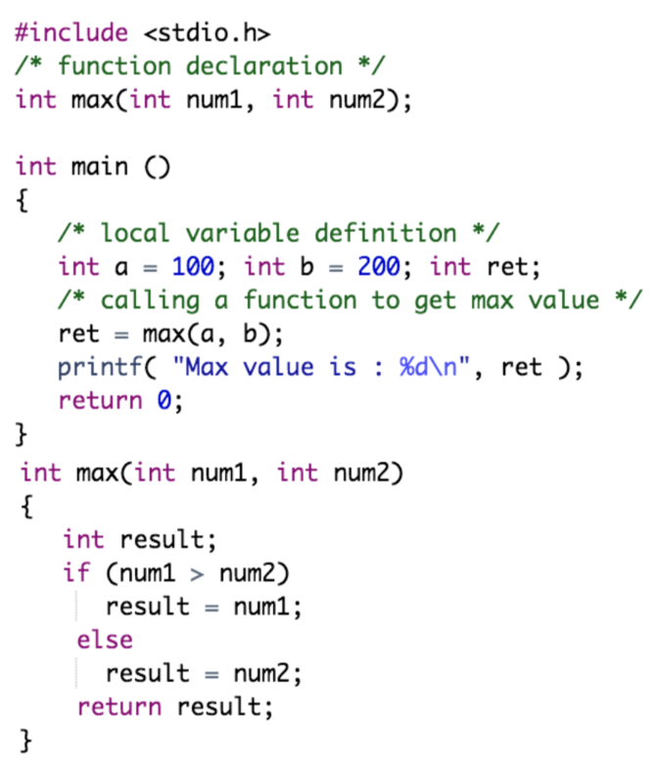
Practical Exercises
Write and Compile the following C programs:
Program 3:

Slide 27
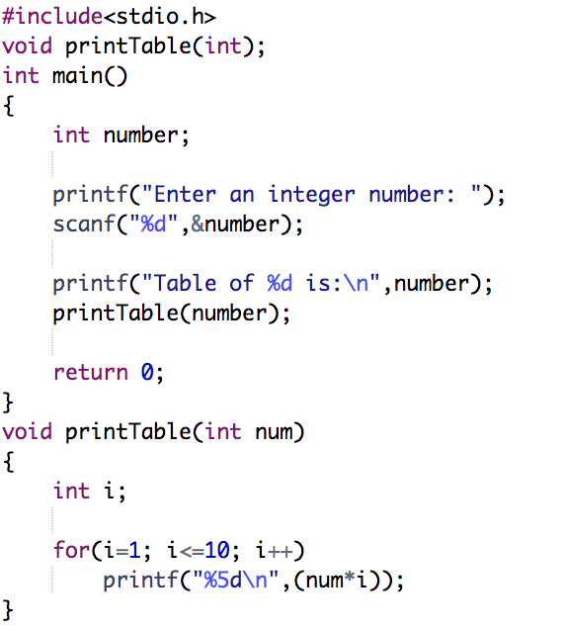
Practical Exercises
Write and Compile the following C programs:
Program 4:

Slide 28
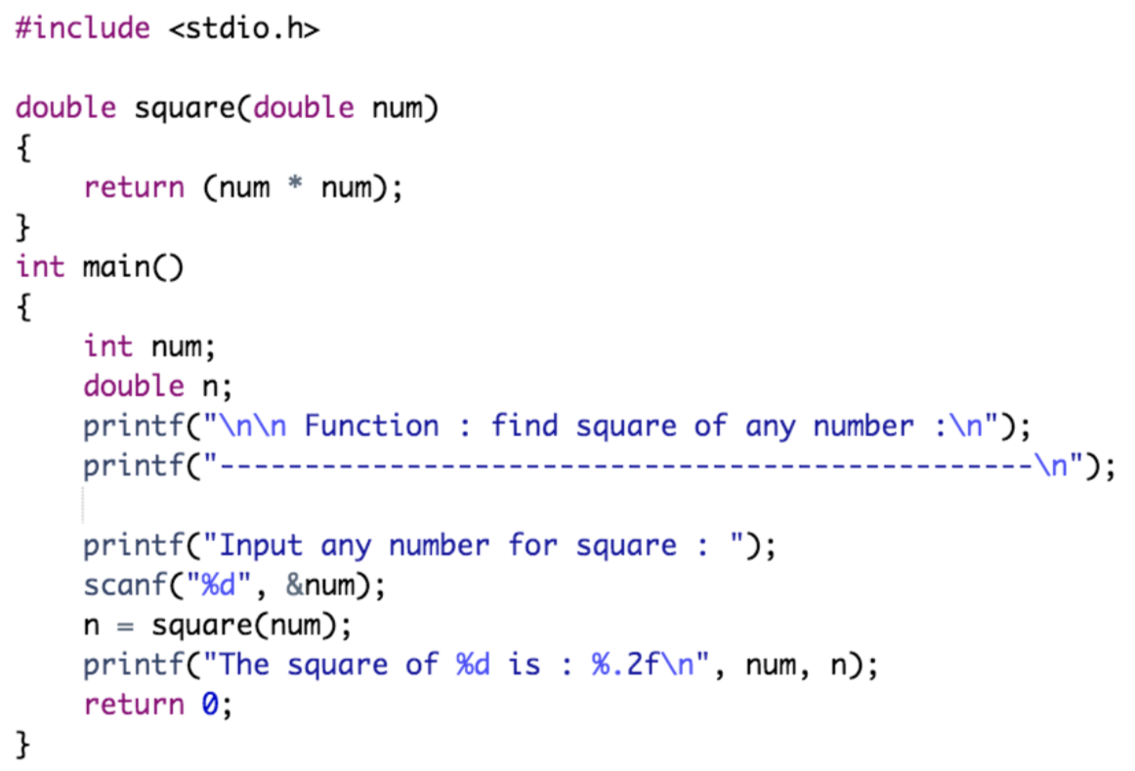
Practical Exercises
Write and Compile the following C programs:
Program 5:

